Slide 1
Assignment 9:ChatBot
S.no. | Name | R.no
1. | Naisargi Bagal | 8
2. | Kashish Dingreja | 18

Slide 2
Table Of Contents
01
02
03
04
Introduction To ChatBot
NLP
NLTK
Terminologies

Slide 3
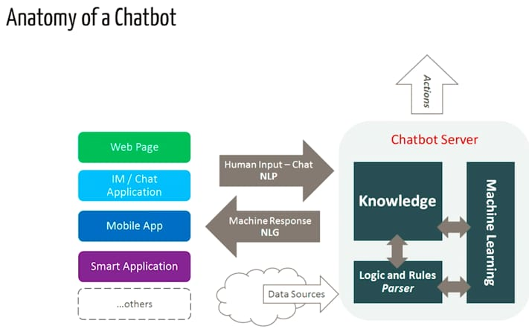
Introduction to ChatBot
A chatbot is an AI software that can simulate a conversation with a user in natural language through messaging applications, websites, mobile apps, or phone calls.
Chatbots are used for various purposes, from customer support to automating routine tasks, answering questions, or even facilitating shopping.
It works by taking human input, processing it using natural language (NLP), applying logic and machine learning to generate a response, and performing actions based on its knowledge and data.

Slide 4
NLP(Natural Language Programming)
NLP is a way for computers to analyze, understand, and derive meaning from human language in a smart and useful way.
By utilizing NLP, developers can organize and structure knowledge to perform tasks such as automatic summarization, translation, named entity recognition, relationship extraction, sentiment analysis, speech recognition, and topic segmentation.

Slide 5
NLTK(Natural Language Toolkit)
NLTK(Natural Language Toolkit) is a leading platform for building Python programs to work with human language data.
It provides easy-to-use interfaces to over 50 corpora and lexical resources such as WordNet, along with a suite of text processing libraries for classification, tokenization, stemming, tagging, parsing, and semantic reasoning, wrappers for industrial-strength NLP libraries.
Available at: http://nltk.sourceforge.net
Requires Python 2.4 or higher
Click 'Download' and follow instructions for your OS
For execution in colab:
pip install nltk

Slide 6
Some terms applied in the code
Tokenization: The process of breaking down text into smaller units.
Stemming: A technique that reduces words to their base or root form by chopping off suffixes.
Lemmatization: Similar to stemming, but more accurate. It reduces words to their base or dictionary form (lemma) based on context and grammar.
Stopwords: Common words (e.g., "the", "is", "in") that are typically removed during text processing because they carry little meaning in determining the sentiment or context of a sentence.
TF-IDF (Term Frequency-Inverse Document Frequency): A numerical statistic used to evaluate how important a word is in a document relative to the entire corpus. It gives higher weight to words that appear frequently in a single document but are rare across other documents.
Cosine Similarity: A measure used to compute the similarity between two vectors (in this case, text represented as vectors), which ranges between 0 and 1, where 1 indicates the texts are identical.

Slide 7
Thank you

